Slide 1


MATLAB & Simulink workshop
Made by: Youssef Ahmed

Slide 2

Session 3
Matrices and functions

Slide 3

Last session recap

Slide 4
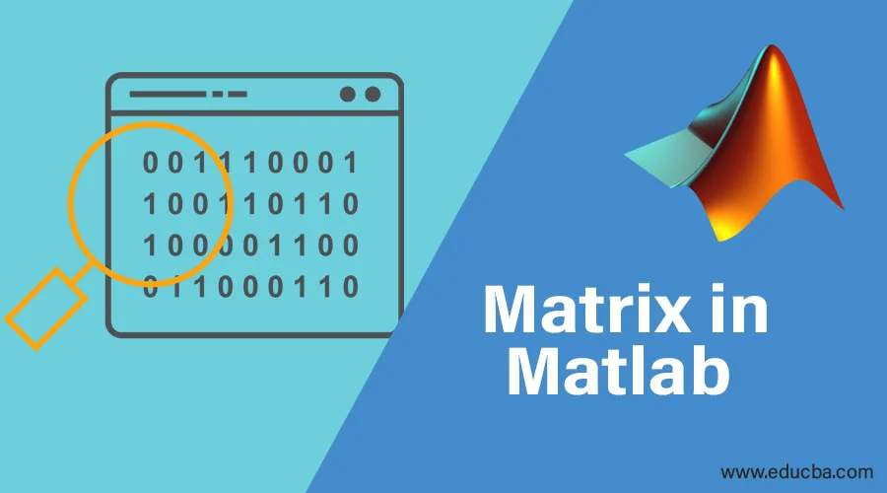
Part 1: matrices

Slide 5
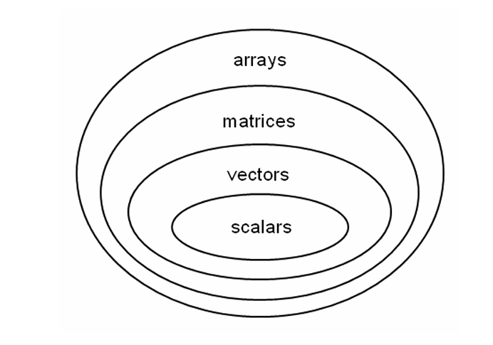
Matrices
Introduction
Remember the difference between:
Array
Matrix
Vector
Scalar

Slide 6
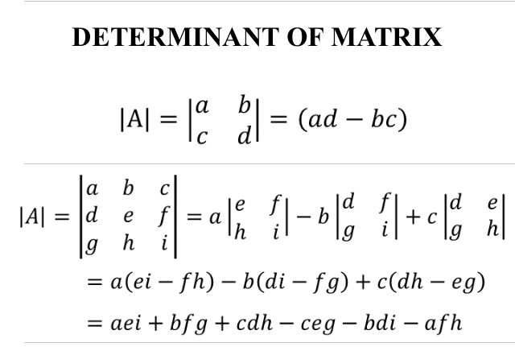
Matrices
Linear algebra
Matrices have a lot of attributes that is used in linear algebra, we will focus on:
1-Matrix determinant

Slide 7
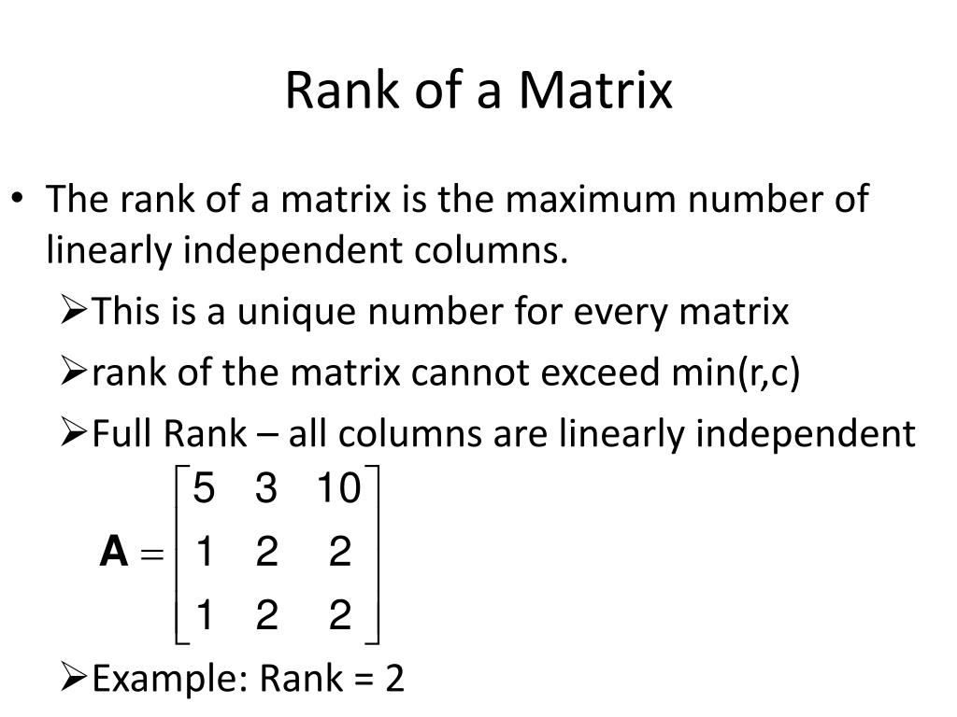
Matrices
Linear algebra
Matrices have a lot of attributes that is used in linear algebra, we will focus on:
2-Matrix rank

Slide 8
Matrices
Linear algebra
What can we take from these attributes?
Matrix singularity
A matrix is called singular if it has no inverse
We can check matrix singularity by checking rank and determinant
If determinant=0 and matrix not full rank -> matrix singular -> no real inverse

Slide 9
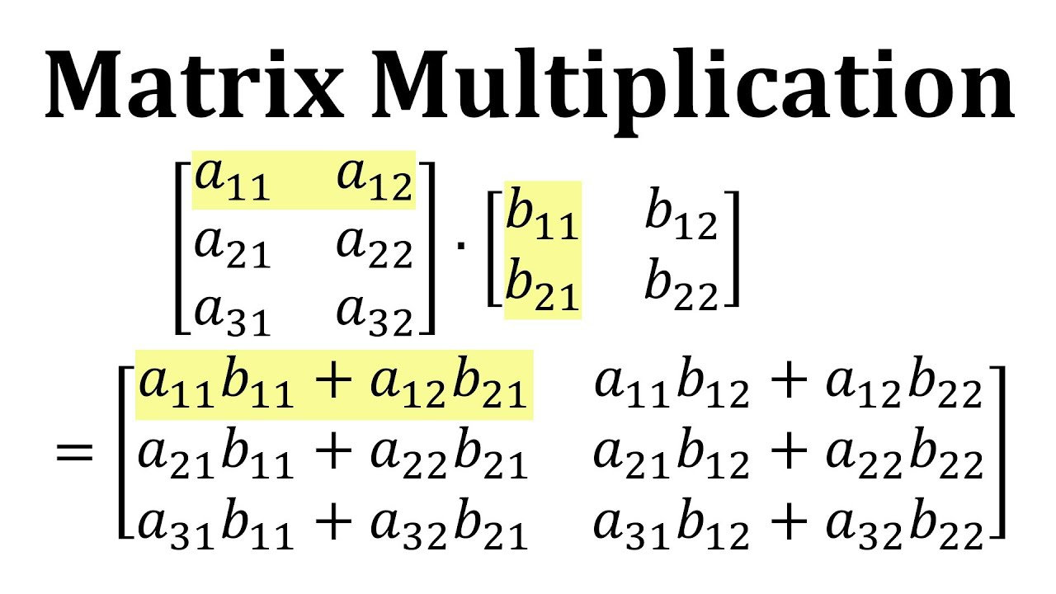
Matrices
Matrix operations
Element wise vs matrix operations
With matrices two operation can be performed
Element wise (every element to other element )
Matrix wise
Example: matrix multiplication

Slide 10
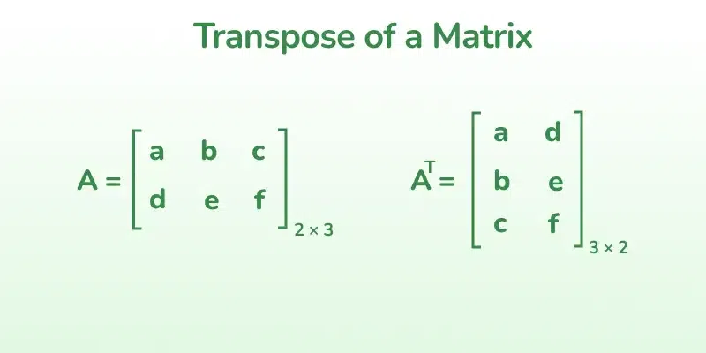
Matrices
Matrix operations
Matrix transpose

Slide 11
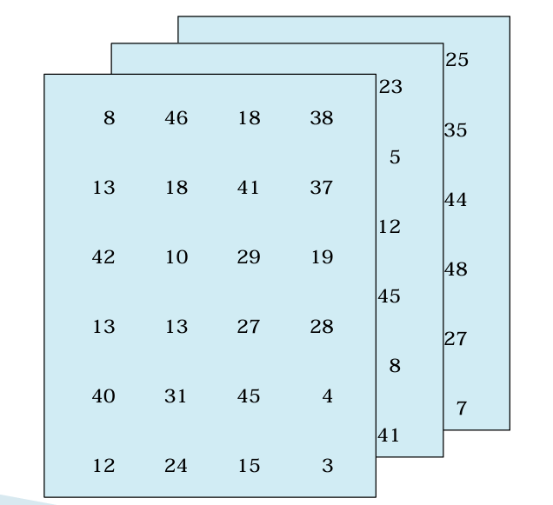
Matrices
Matrix operations
3D arrays

Slide 12

MATLAB time!
Now let’s see what we covered so far in MATLAB

Slide 13
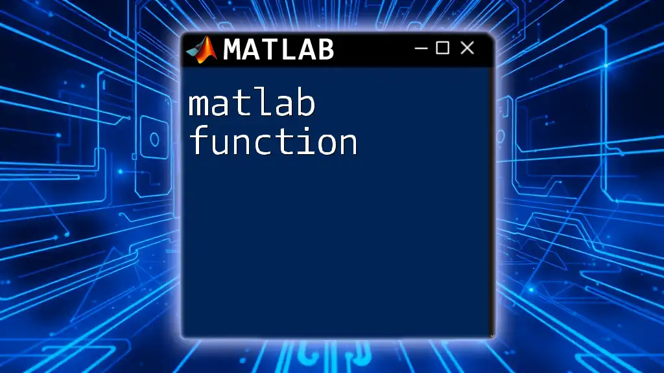
Part 2: functions

Slide 14
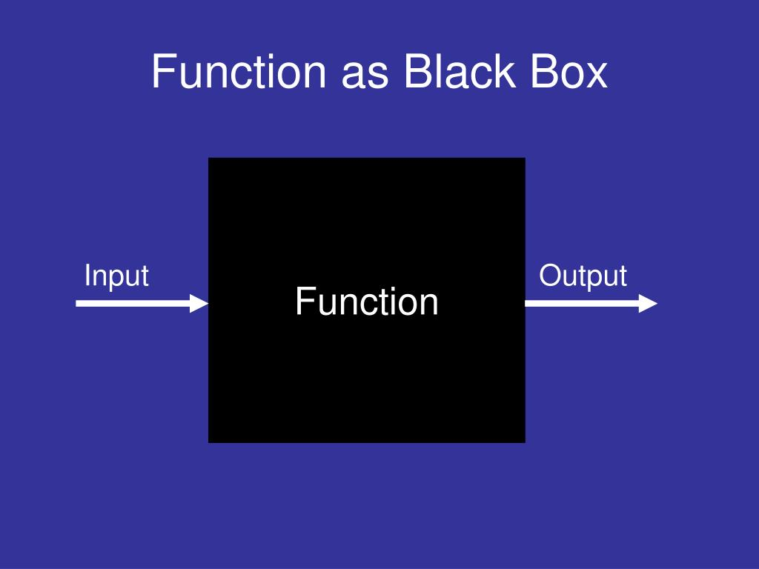
Functions
Introduction
We can think of a function as of a black box

Slide 15
Functions
Function documentation
In MATLAB built-in functions there are two important commands:
help
doc
Why?
While working in real project with MATLAB you will spend some decent time reading documentation

Slide 16
Functions
Rules
In MATLAB there is a set of rules we need to follow when making functions:
Function must be in separate .m file and in top of the file
Function name must match the name of the file
Functions have their own scope (workspace) that cannot be accessed outside of its function

Slide 17
Functions
Polymorphism
To use polymorphism in functions we use these special variables:
nargin
nargout
varargin
varargout

Slide 18
MATLAB time!
Now let’s see what we covered so far in MATLAB

Slide 19
MATLAB skill
Now let’s discuss some tips and tricks when using MATLAB scripts

Slide 20
Thank you!

